Slide 1

BC2410, Prescriptive Analytics From Data to Decisions
Lecture 1

Slide 2
Admin Matters
Lecturer
Dr. TANG Qinshen
Division of Information Technology & Operations Management
Email: qinshen.tang@ntu.edu.sg
Office hour: Thursday, 2-4 pm (S3-B1B-56 or Zoom)
(Sending an email before the meeting with all your problems is preferable.)
Zoom: https://ntu-sg.zoom.us/j/91641090709
Meeting ID: 916 4109 0709
Passcode: 668352

Slide 3
Admin Matters
Mode – Weekly Lecture (4 hrs)
Refer to NTULearn regularly for lessons updates and announcements
References (Not mandatory; lecture notes provided will be sufficient)
Python Programming (https://docs.python.org/3/tutorial/)
RSOME Python Package (https://xiongpengnus.github.io/rsome/. Developed by Dr. CHEN Zhi and Dr. XIONG Peng)
Gurobi Optimization solver(http://www.gurobi.com/)
Gerard Cornuejols and Reha Tütüncü. Optimization Methods in Finance. Vol. 5. Cambridge University Press.
Frederick S. Hillier. Introduction to Operations Research. Tata McGraw-Hill Education, 2012.
Christian Albright and Wayne L. Winston. Business Analytics: Data Analysis and Decision Making. Cangage Learning, 2015.
Dimitris Bertsimas, Allison O'Hair and Bill Pulleyblank. The Analytics Edge, Dynamic Ideas, 2016. ISBN: 978-0989910897.
Gilbert Strang. Introduction to Linear Algebra. 5th ed. Wellesley, MA: Wellesley-Cambridge Press, February 2016. ISBN: 9780980232776

Slide 4
Coding Platform
Programming in Python expected
Tutorials can be found here:
https://docs.python.org/3.6/tutorial/index.html
https://www.tutorialspoint.com/python3/index.htm
http://cs231n.github.io/python-numpy-tutorial/
Jupyter Notebook
Available in Anaconda
More convenient interactive environment
Better illustration and readability by combining code with Markdown
Project will be based on Jupyter notebook

Slide 5
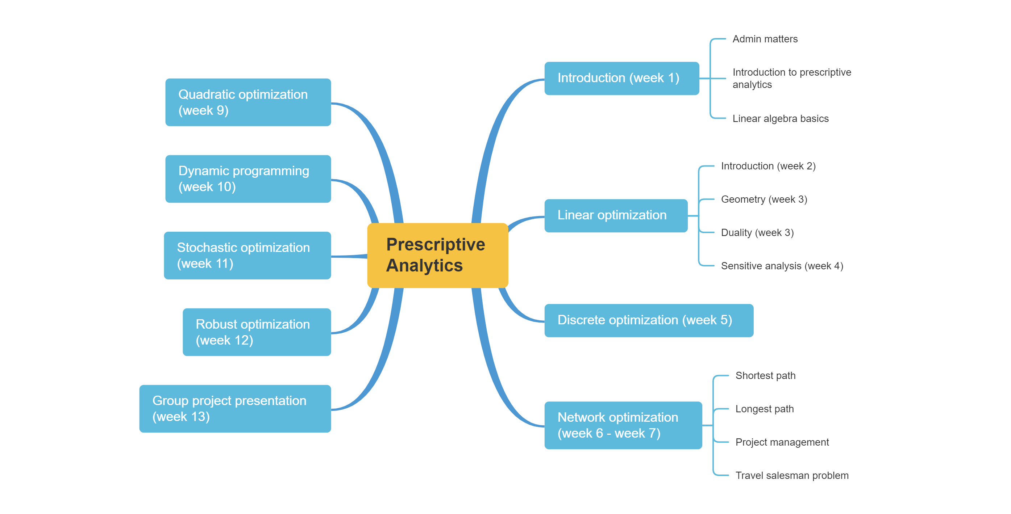
Schedule

Slide 6
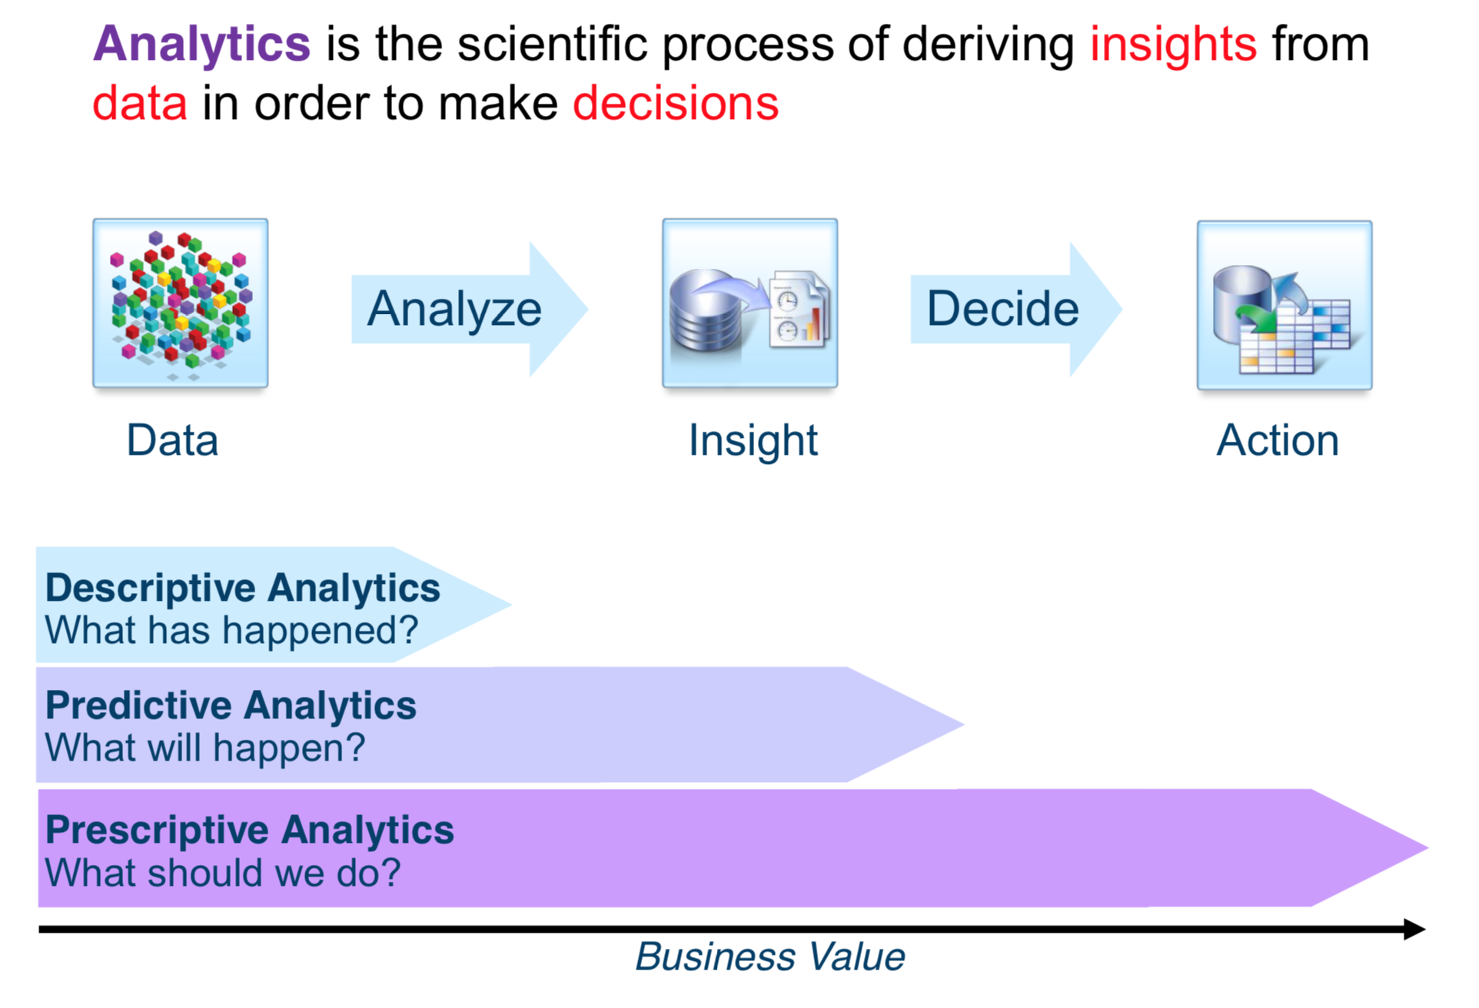
What is Analytics?

Slide 7
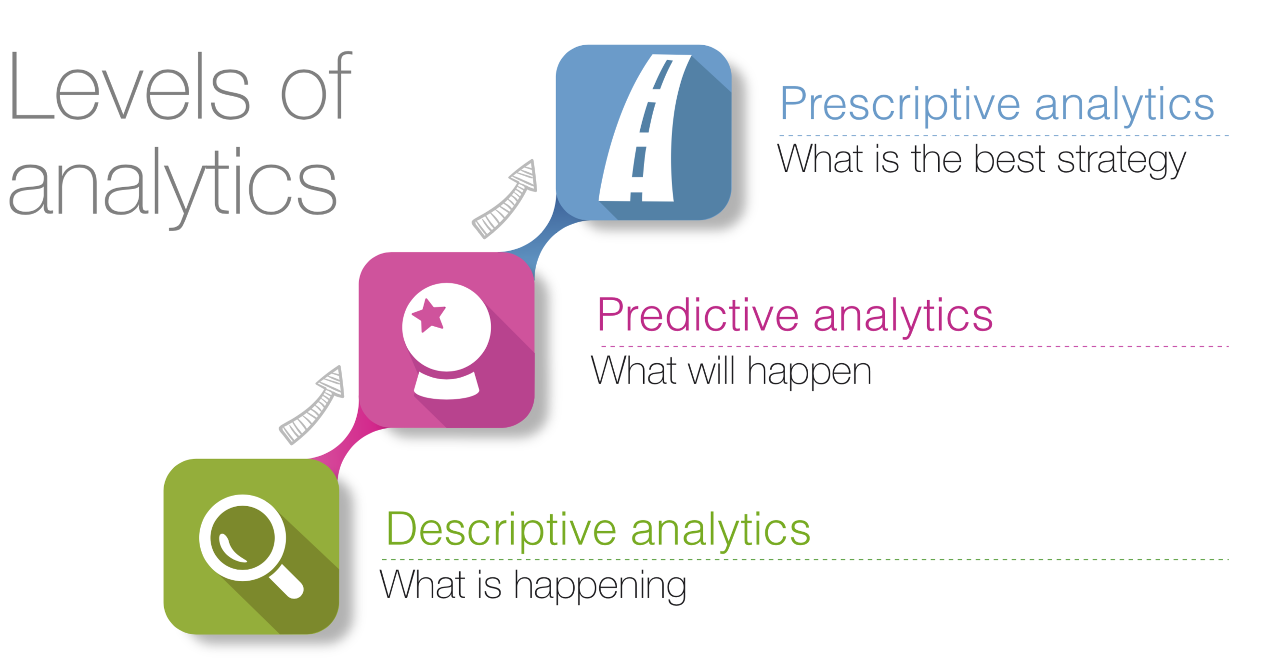
What is Analytics?

Slide 8
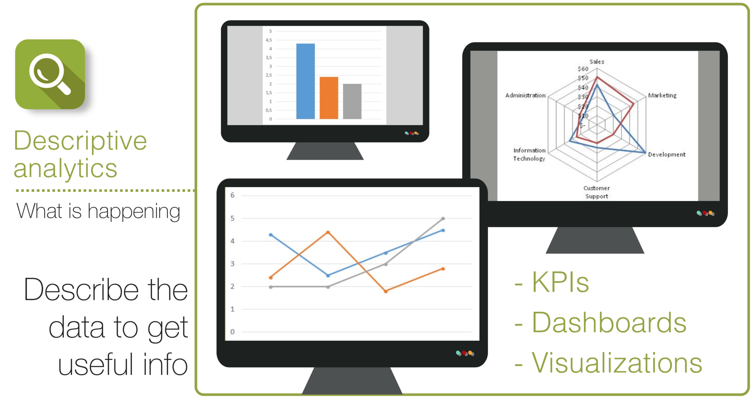

Slide 9
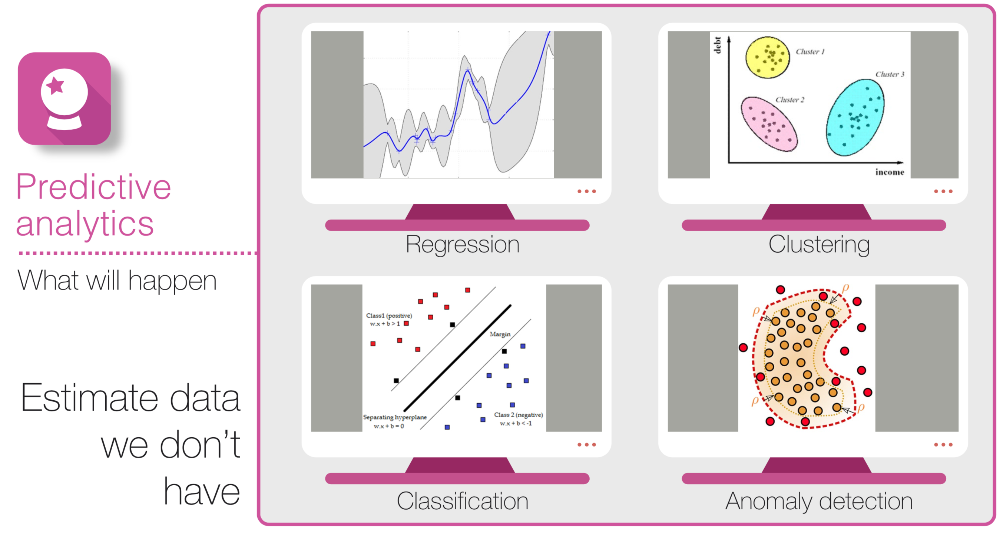

Slide 10
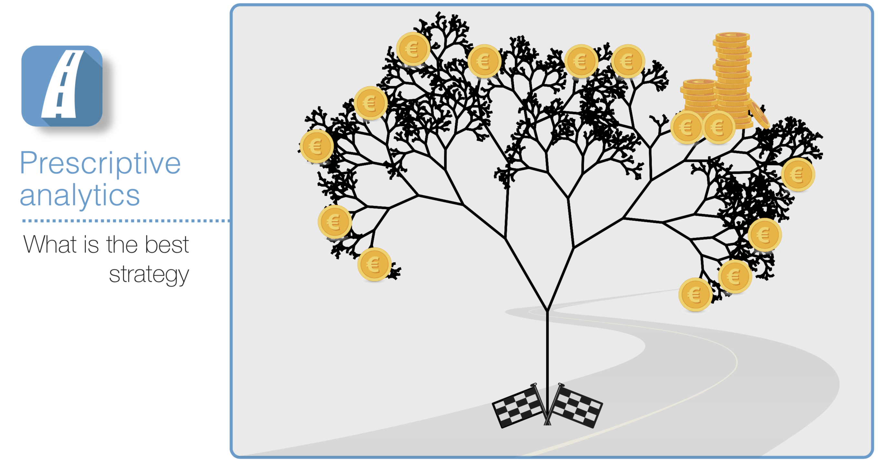

Slide 11


Slide 12
Why Optimization?
Globalized economy requests businesses to compete with
lower cost,
higher efficiency, and
better services

Slide 13
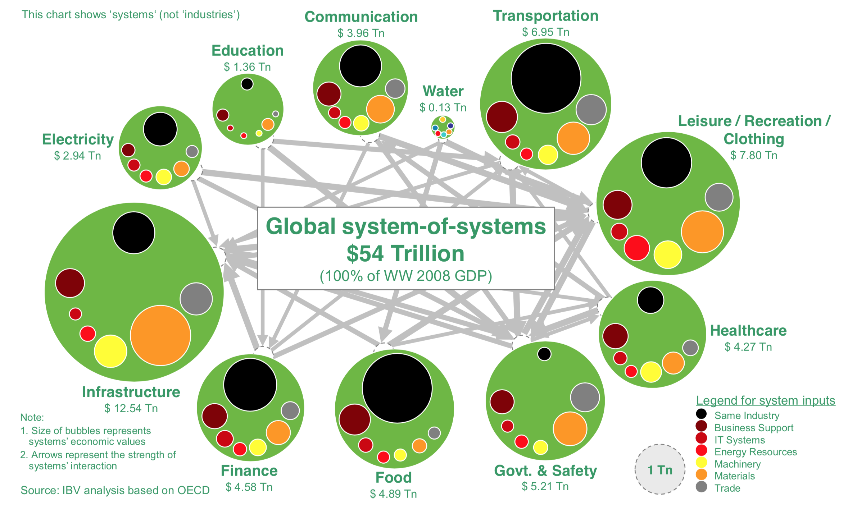
Global Economy

Slide 14
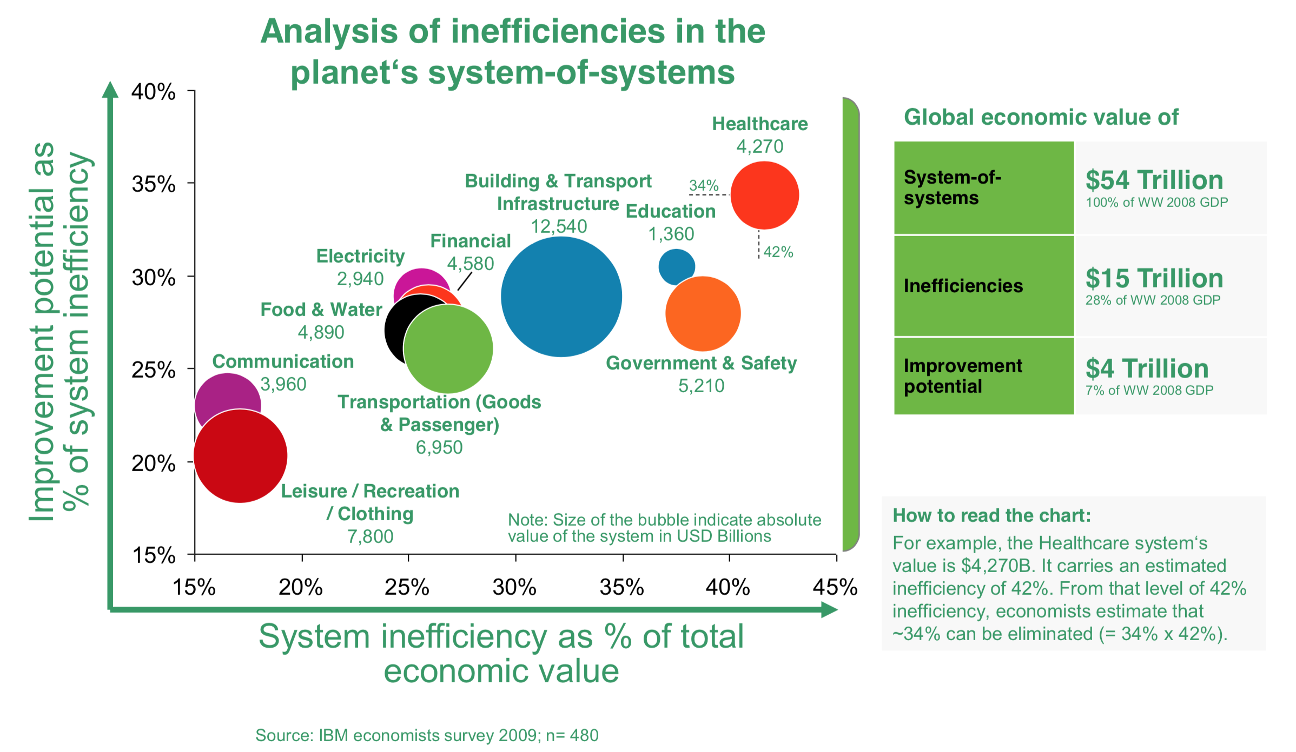
Optimizing the Global Economy
Economists estimate, that all systems carry inefficiencies of up to $15 Tn, of which $4 Tn could be eliminated

Slide 15
Why Optimization?
Globalized economy requests businesses to compete with
lower cost,
higher efficiency, and
better services
Optimization become a key factor on which more and more firms focus to maintain and enhance their competency.

Slide 16
What You Should Expect
Mathematical Thinking
Understand the basic logic behind algorithms
Understand the general principles in optimization
Judgement on the difficulty of a problem; be able to assess the quality of a solution
Analytics Skills
Building up models
Picking the right tools
Implementing in Software

Slide 17
What You Should Expect
You are a(n):
Student
Business analyst
Data scientist
Project manager
Decision maker
Seller
Investor
….
I am a(n):
Instructor
Facilitator
Friend

Slide 18
What I Expect
Prerequisite
Linear algebra; Programming
Assessment
Class Participation (10%)
Group Assignment (20%)
Group Project (30%)
Problem Description: 5%
Optimization Modeling: 5%
Python/RSOME Code: 5%
Discussion of solutions: 5%
In-class presentation: 10%
Final Exam(40%)

Slide 19
Group Project
Apply the analytical techniques to a business problem of your choosing
Motivation and statement of the problem
Methodology and processes of solving the problem
Analysis and interpretation of the results
Include Python code (RSOME) for solving the optimization problem.

Slide 20
Some Requirements
Please bring your laptop
COVID-19 safe regularizations
Face mask must be worn at all times
Please strictly follow the sitting plans

Slide 21
Linear Optimization Problem (LOP)
Decision variables, denoted by unknowns. Say, x, y, z… (or x₁, x₂, x₃)
Data, denoted by a, b, c…(parameters)
An objective function, say 2x+3y-z, to be minimized/maximized
A set of constraints, denoted by equations or inequalities

Slide 22
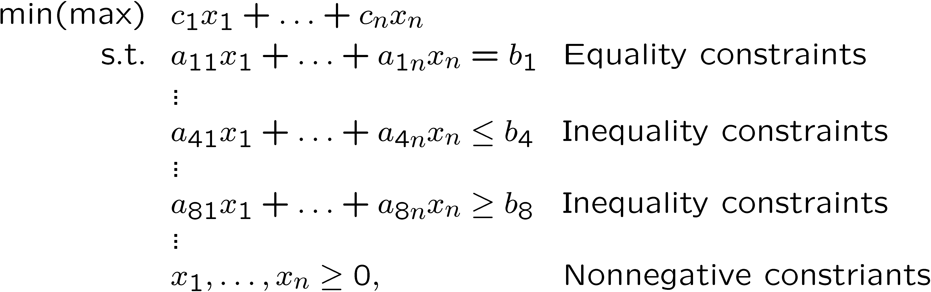
Linear Optimization Problem (LOP)
General Framework

Slide 23
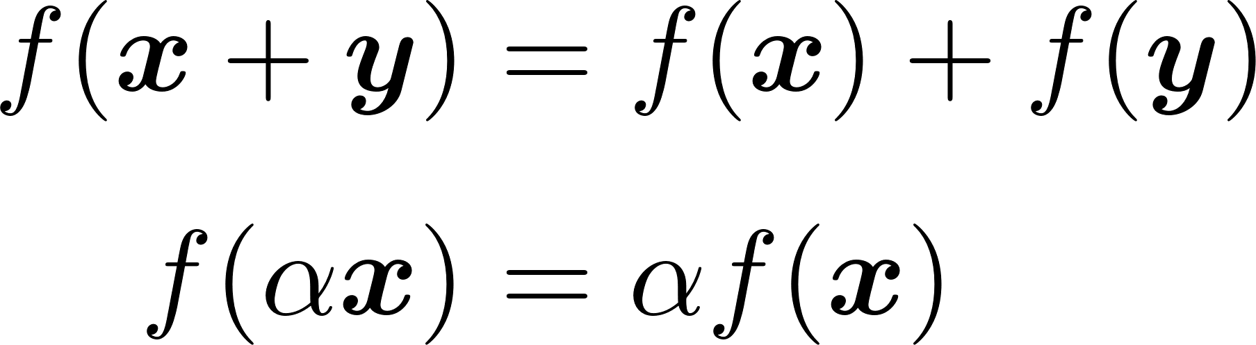
Formulation of LOP
What is a linear function?
A linear function is a linear mapping that satisfies:

Slide 24
Where does LOP arise?
Management – manufacturing, banking, marketing, transportation, communication, …
Engineering – design of products, data analysis, …
Science – medicine, biology, geometry, chemistry, physics,…
Sudoku

Slide 25
A LOP Example:
A furniture company makes tables and chairs
Production require wood, finishing labor and carpentry labor.
 | Desk | Table | Chair | Avail.
Profit | 60 | 30 | 20
Wood | 8 | 6 | 1 | 48
Finish Hrs | 4 | 2 | 1.5 | 20
Carpentry Hrs | 2 | 1.5 | 0.5 | 8

Slide 26
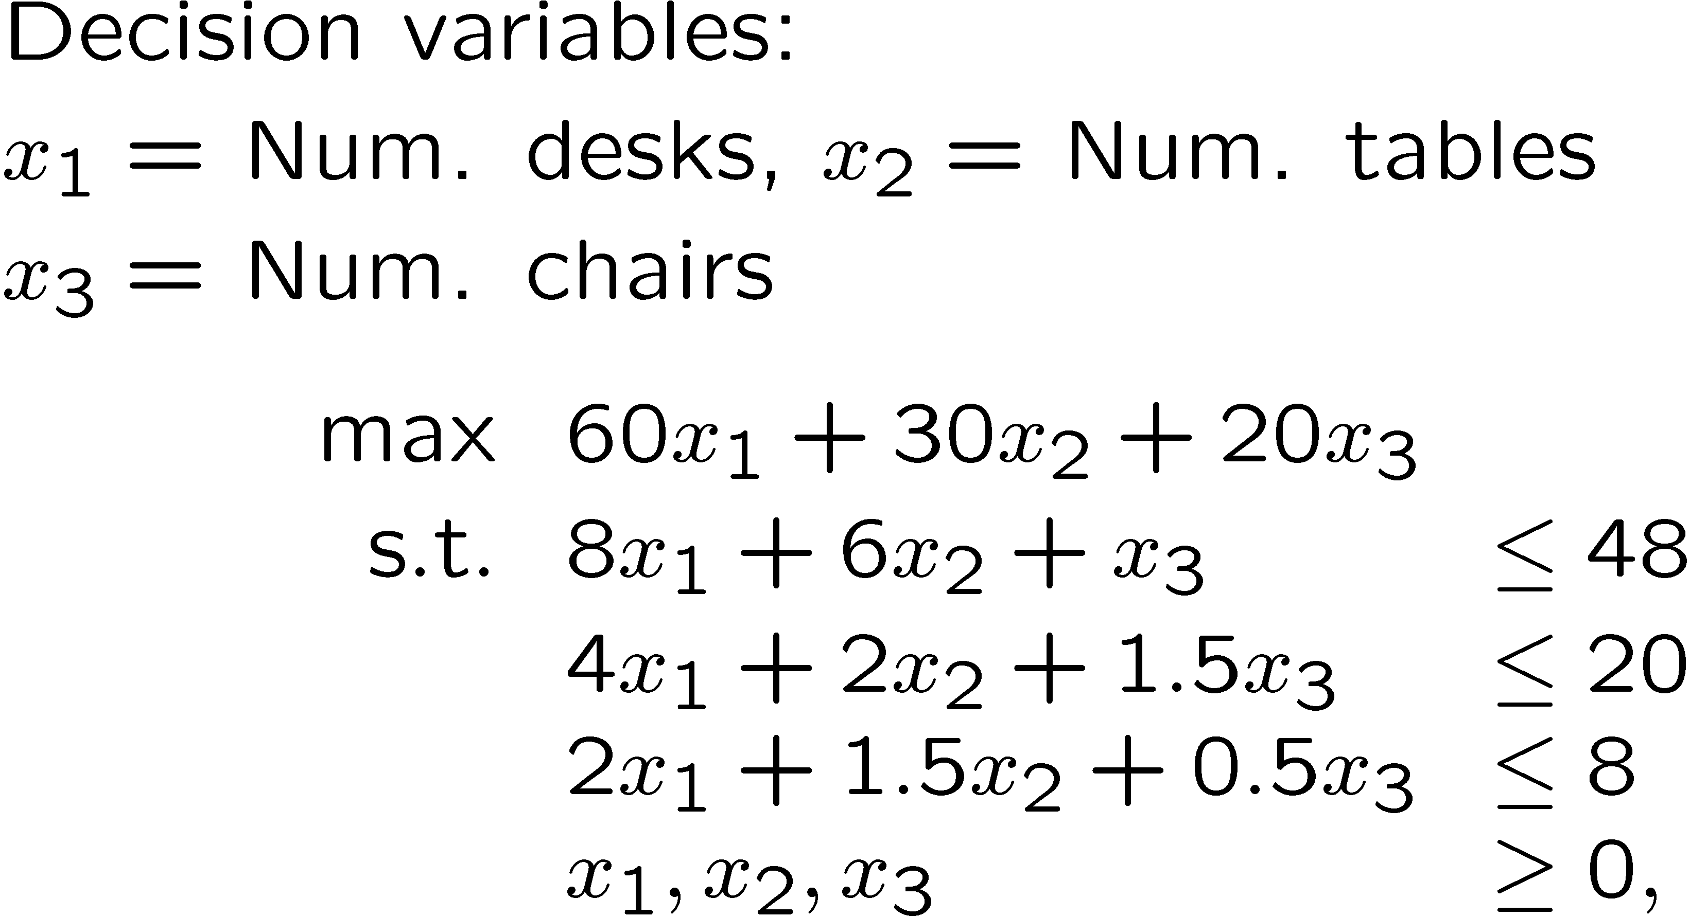
LOP Example:

Slide 27
LOP Models
We maximize (or minimize) a linear function (called the objective function) of the decision variables.
Decision variables must satisfy a set of constraints. Each constraint must be a linear equation ( = ) or linear inequality ( >= or <=).

Slide 28
LOP Models
Usually, sign restriction is associated with each decision variable. However, a variable may be unrestricted in sign (say, temperature).
By convention, constraints are written such that all the decision variables are on the LHS, while the constant is on the RHS.

Slide 29
Basic Math Notations
A set is a collection of distinct objects.
Check Wiki “Set”
Examples:
Notes:
See all definitions at: https://en.wikipedia.org/wiki/Set_(mathematics)

Slide 30
Basic Math Notations

Slide 31
Basic Math Notations
Membership
Notes:
Proper subset: ⊊

Slide 32
Basic Math Notations
Basic operations
Union
Intersection

Slide 33
Basic Math Notations
Special Sets
Notes:
Empty set: ∅

Slide 34
Basic Math Notations
Summation
Notes:
a11x11 + a12x12 + a21x21 + a22x22 + a31x31 + a32x32 You can also fix i in S and express j in T first:
sum_{i in S}(ai1 xi1 + ai2 xi2) = a11x11 + a12x12 + a21x21 + a22x22 + a31x31 + a32x32

Slide 35
Basic Math Notations
Notes:
Three elements in V
Each is a vector

Slide 36

Elementary Linear Algebra
Scalar
Variable described by a single number
Vector
Column of numbers
Essence of Linear Algebra: https://youtube.com/playlist?list=PL0-GT3co4r2y2YErbmuJw2L5tW4Ew2O5B

Slide 37
Matrices
Rectangular display of vectors in rows and columns
Defined as rows x columns (R x C)
Vector is just a n x 1 matrix

Slide 38

Columns of Matrices
Notes:
A vector is also a matrix

Slide 39
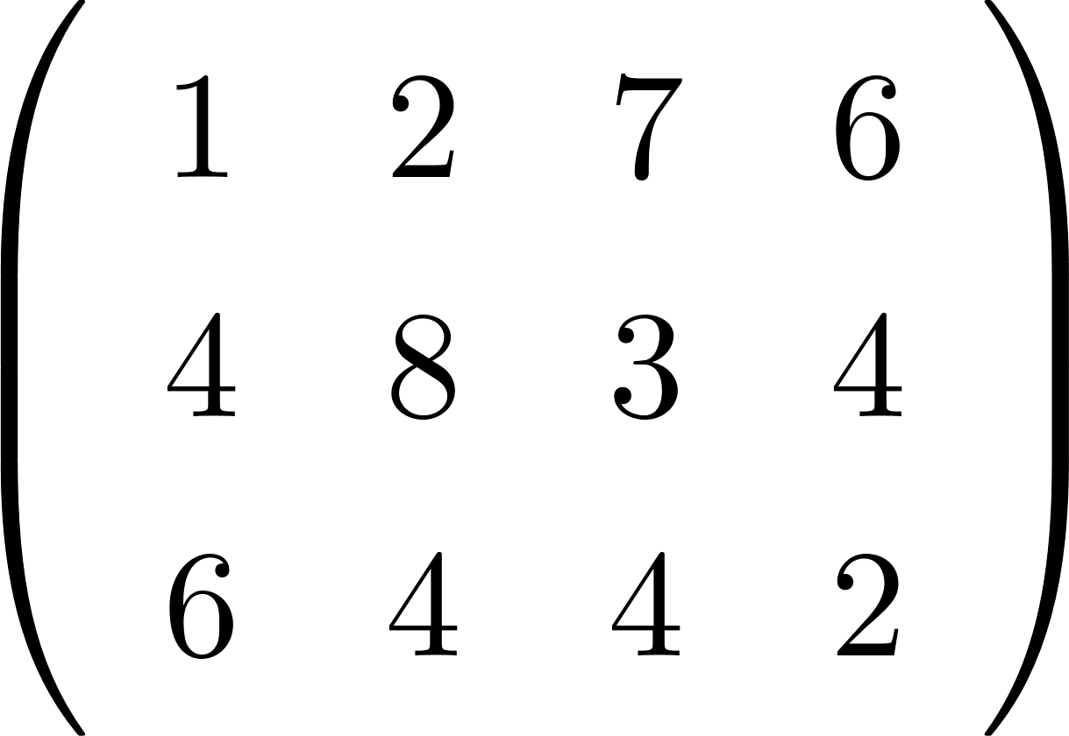
Transposition
Reflect over its main diagonal:
Write the rows of A as the columns of A
Notes:
Sometimes we also use T to denote transposition

Slide 40

Rows of Matrices
Notes:
a_1^T is a row vector a_1 is a column vector

Slide 41
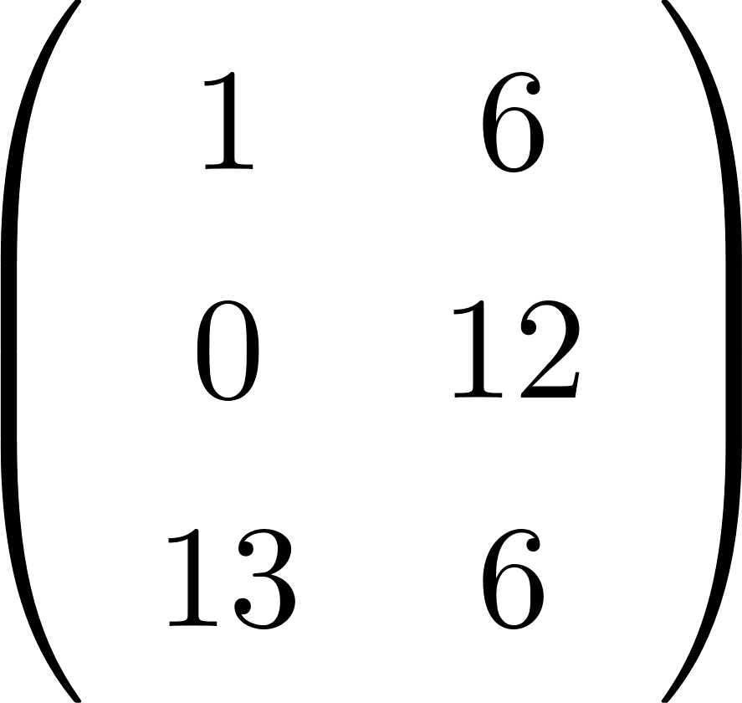
Matrix Calculations
Addition
Commutative: A+B=B+A
Associative: (A+B)+C=A+(B+C)
Size of matrix must agree
Subtraction
By adding a negative matrix

Slide 42
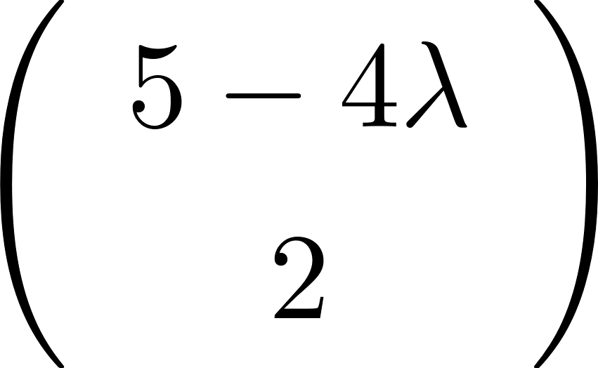
Scalar multiplication
Scalar x matrix = scalar multiplication
Notes:
Scalar times a vector: each element of the vector will times the scalar

Slide 43
Scalar multiplication
Line segment:
Notes:
Do you know what does it mean?

Slide 44
Matrix Multiplication
When A is a mxn matrix & B is a kxl matrix, AB is only possible if n=k. The result will be an mxl matrix
= m x l matrix
Number of columns in A = Number of rows in B
Notes:
Attention: n in matrix B should be k

Slide 45
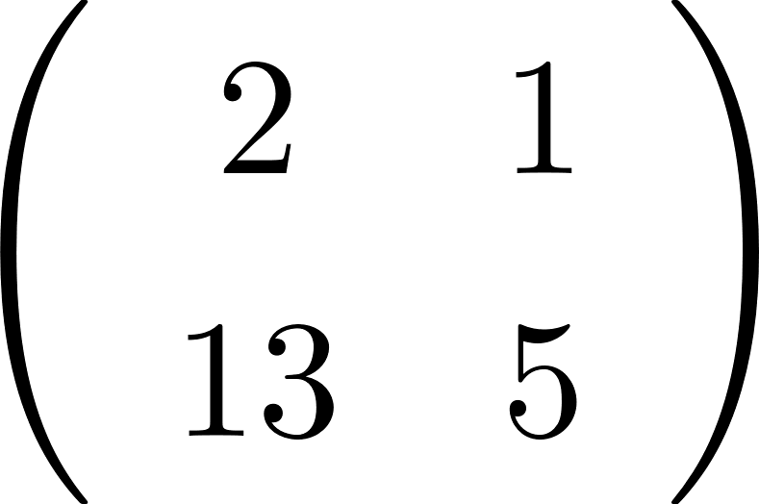
Matrix Multiplication
Multiplication method:
Sum over product of respective rows and columns
=
A
B

Slide 46
Matrix Multiplication
How many operations are needed to multiply 2 matrices:
Number of multiplication:
Notes:
n should be k

Slide 47
Matrix Multiplication
Matrix multiplication is NOT commutative
AB≠BA
Matrix multiplication IS associative
A(BC)=(AB)C
Matrix multiplication IS distributive
A(B+C)=AB+AC
(A+B)C=AC+BC

Slide 48
Matrix Multiplication
Notes:
Be familiar with this way of writing summation

Slide 49
Matrix Multiplication
Notes:
Can you derive it by yourself? Just remember how to do the matrix calculation
Practice and you will know

Slide 50
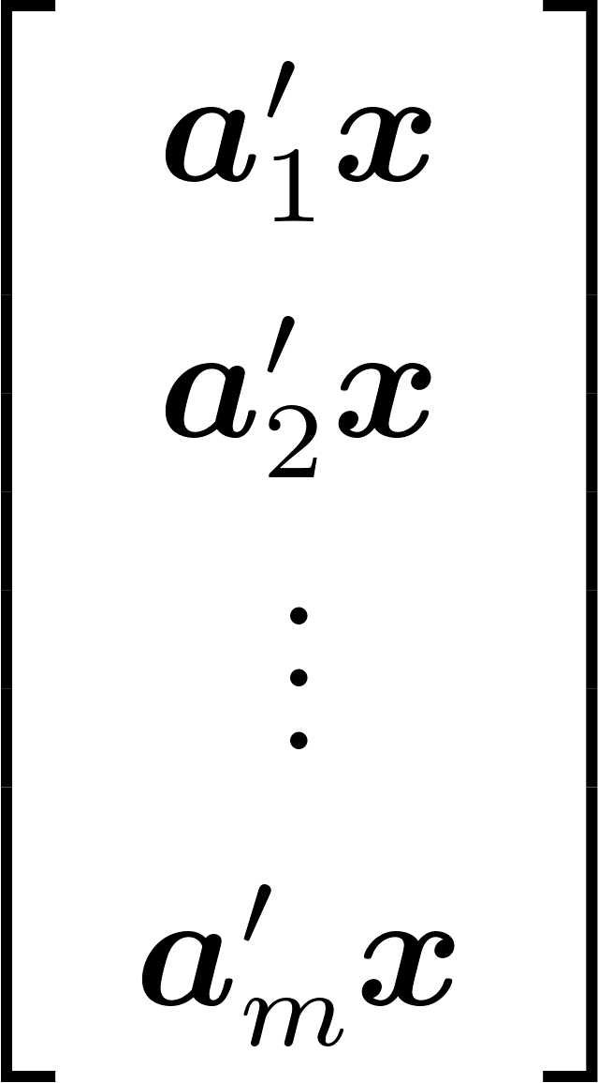
Matrix Multiplication

Slide 51
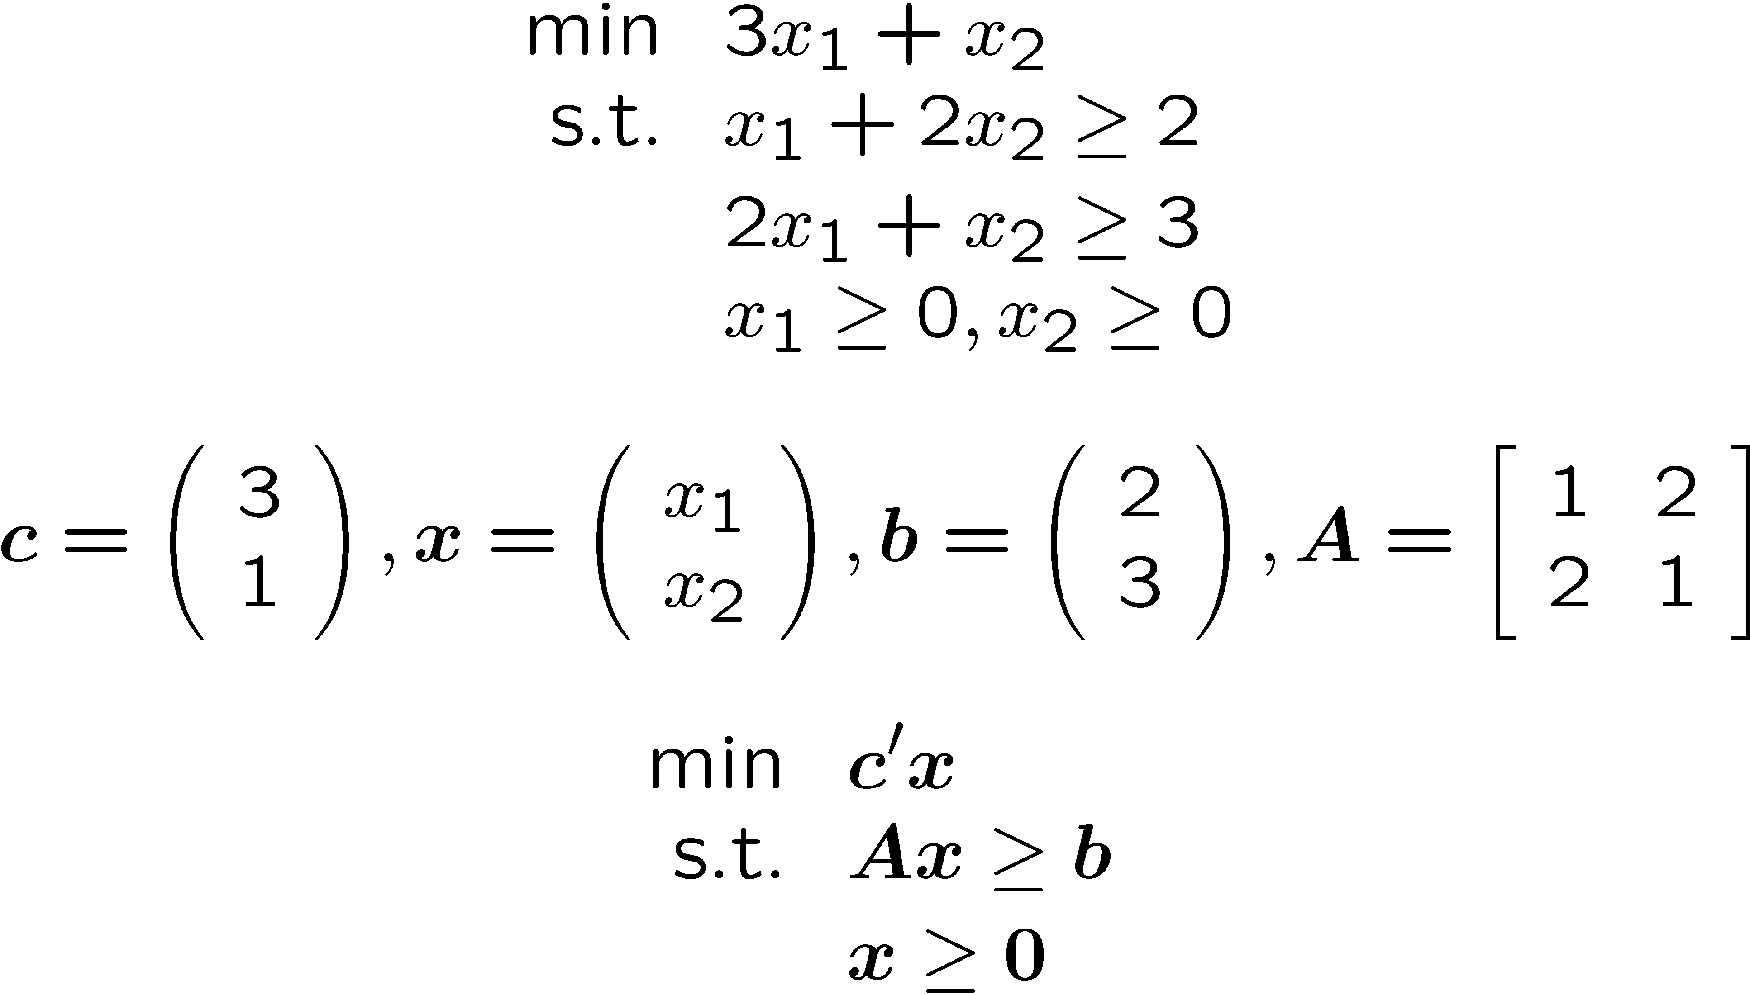
Matrix Representation of LOP
Formulation

Slide 52
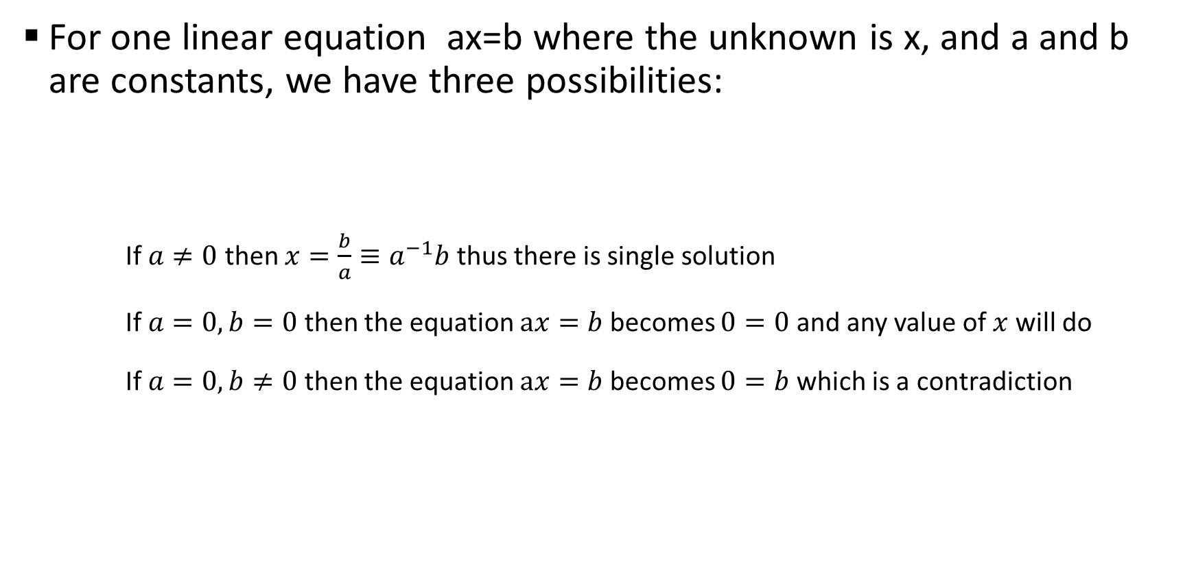
Solving simultaneous equations
For one linear equation ax=b where the unknown is x, and a and b are constants, we have three possibilities:
If $a≠0$ then $x=\frac{b}{a}≡a^{−1}b$ thus there is single solution
If $a=0, b=0$ then the equation $ax=b$ becomes $0=0$ and any value of $x$ will do
If $a=0, b≠0$ then the equation $ax=b$ becomes $0=b$ which is a contradiction

Slide 53
Solving simultaneous equations
Eg. Two equations, two unknowns
In matrix form
Notes:
Attention: 1 on the right hand side vector should be -1

Slide 54
Solving simultaneous equations
If A is invertible or det(A) is not zero then x is uniquely defined.
Notes:
Definition of determinant of matrix: https://en.wikipedia.org/wiki/Determinant
Python to check: numpy.linalg.det(A)

Slide 55
Solving simultaneous equations
If A is not invertible, then it could have more than one solutions…

Slide 56
Solving simultaneous equations
Or no solutions at all…

Slide 57

Additional information
Other important topics on Linear Algebra
Positive/Semi-positive definite matrices
Eigen values/vectors
Recommended videos:
Essence of Linear Algebra (https://youtube.com/playlist?list=PL0-GT3co4r2y2YErbmuJw2L5tW4Ew2O5B )
Introduction to Linear Algebra by Gilbert Strang (https://www.youtube.com/watch?gl=SG&hl=en-GB&v=ZK3O402wf1c)

Slide 58
Python Basics
Python is an interpreted high-level programming language for general-purpose programming.
Created by Guido van Rossum and first released in 1991.
Python has a design philosophy that emphasizes code readability, notably using significant whitespace.
It supports multiple programming paradigms, including object-oriented, imperative, functional and procedural, and has a large and comprehensive standard library.
Python interpreters are available for many operating systems.
More tutorials can be found here:
https://docs.python.org/3.7/tutorial/index.html
https://www.tutorialspoint.com/python3/index.htm
http://cs231n.github.io/python-numpy-tutorial/

Slide 59
Install Anaconda (for Python)
Anaconda
It includes over 330 Python and R packages such as an Integrated Development Environment (Spyder) and the leading web interactive notebook for data science (Jupyter).
Gurobi
A commercial optimization solver for linear programming (LP), quadratic programming (QP), quadratically constrained programming (QCP), mixed integer linear programming (MILP), mixed-integer quadratic programming (MIQP), and mixed-integer quadratically constrained programming (MIQCP).
RSOME
RSOME is an algebraic package, developed by Dr. CHEN Zhi and Dr. XIONG Peng.
https://xiongpengnus.github.io/rsome/

Slide 60
Install Anaconda (for Python) and Gurobi
Step1
Go to http://www.gurobi.com/downloads/get-anaconda and select your system (WIN 32bit or WIN 64bit or Mac) and Python version 3.6.
Step 2
Follow the instruction in the above link to install Gurobi into Anaconda
Step 3
Install a Gurobi License.

Slide 61
Gurobi Free Academic License
Request at https://www.gurobi.com/downloads/end-user-license-agreement-academic/ using your NTU email.
Go to https://www.gurobi.com/academia/academic-program-and-licenses/ and click “Free Academic License page” to obtain and install the free academic license
Optional
In case you cannot find "grbgetkey", you may download Gurobi Optimizer at http://www.gurobi.com/downloads/gurobi-optimizer. And try Step 3 again.

Slide 62
Install Anaconda (for Python) and Gurobi
Step1
Go to http://www.gurobi.com/downloads/get-anaconda and select your system (WIN 32bit or WIN 64bit or Mac) and Python version 3.7.
Step 2
Follow the instruction in the above link to install Gurobi into Anaconda
Step 3
Install a Gurobi License.
Step 4
Test your installation by running “from gurobipy import *” in your Jupyter Notebook

Slide 63
Setting up Python
Command Line
More flexible, for example, you can add additional arguments when executing the code file.
Jupyter Notebook
Available in Anaconda
More convenient interactive environment
Better illustration and readability by combining code with Markdown

Slide 64
Get Python 3.7 in Anaconda
(If you encounter some errors in installing Gurobi in Python 3.8)

Slide 65
Get Python 3.7 in Anaconda
Two ways to do it:
Downgrade your python version in Anaconda
Create a new environment in Anaconda

Slide 66
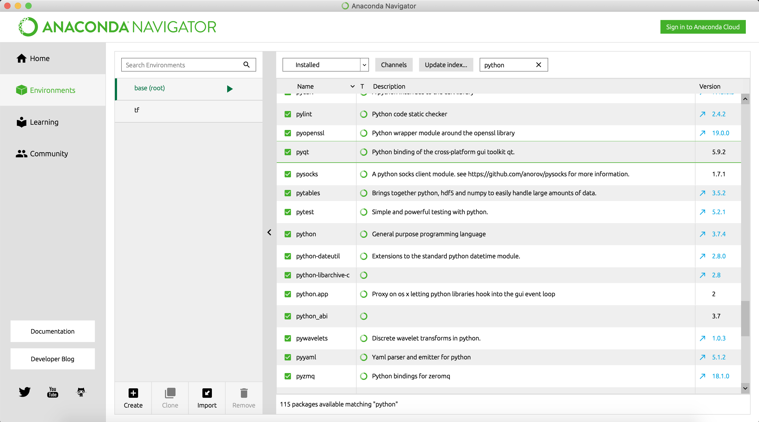
1. Downgrade your python
Find out your python version (on the right). If you encountered problem installing Gurobi, your version should be 3.8.x, we need to downgrade it to 3.7.x

Slide 67
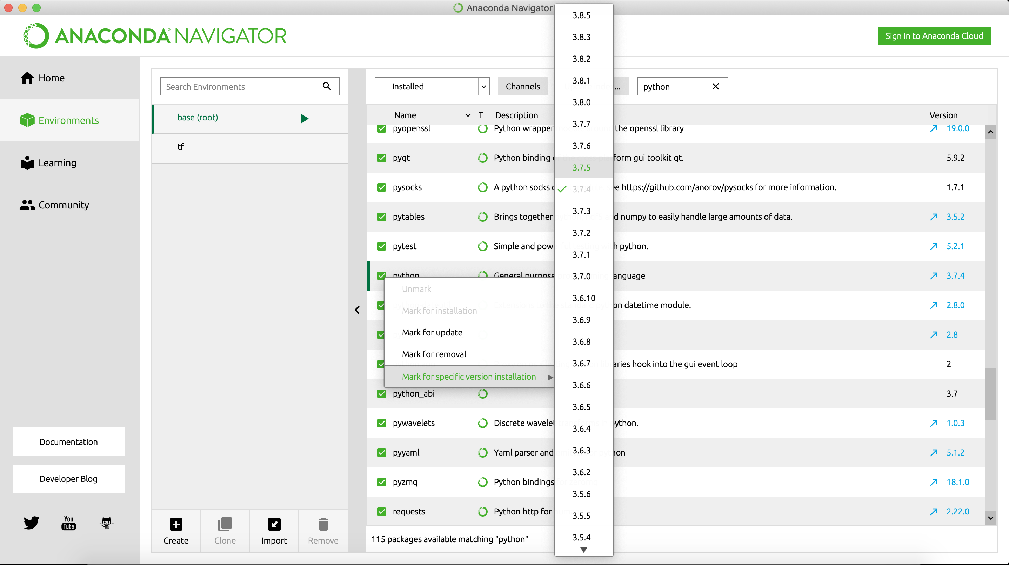
1. Downgrade your python
Click the green tick in front of python, then choose a version 3.7.x (here 3.7.6 for example)

Slide 68
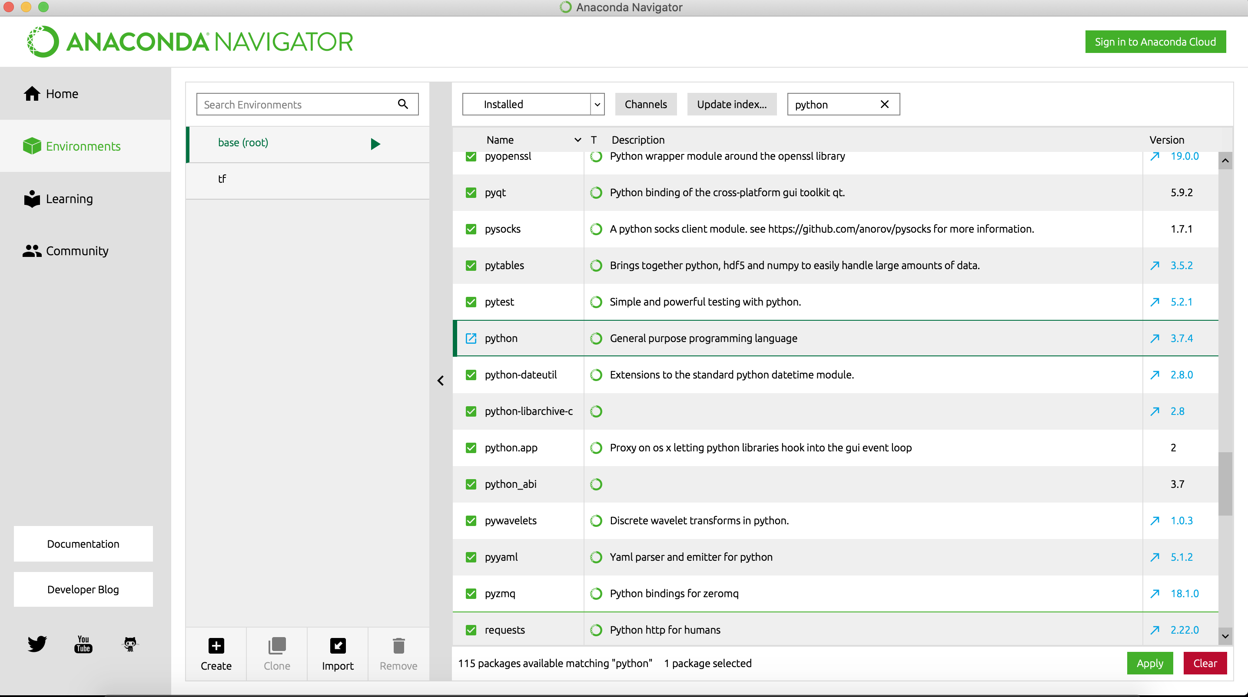
1. Downgrade your python
Click Apply, then follow the instruction. Once this is completed, your python version should be 3.7.x. Then try installing Gurobi again.

Slide 69
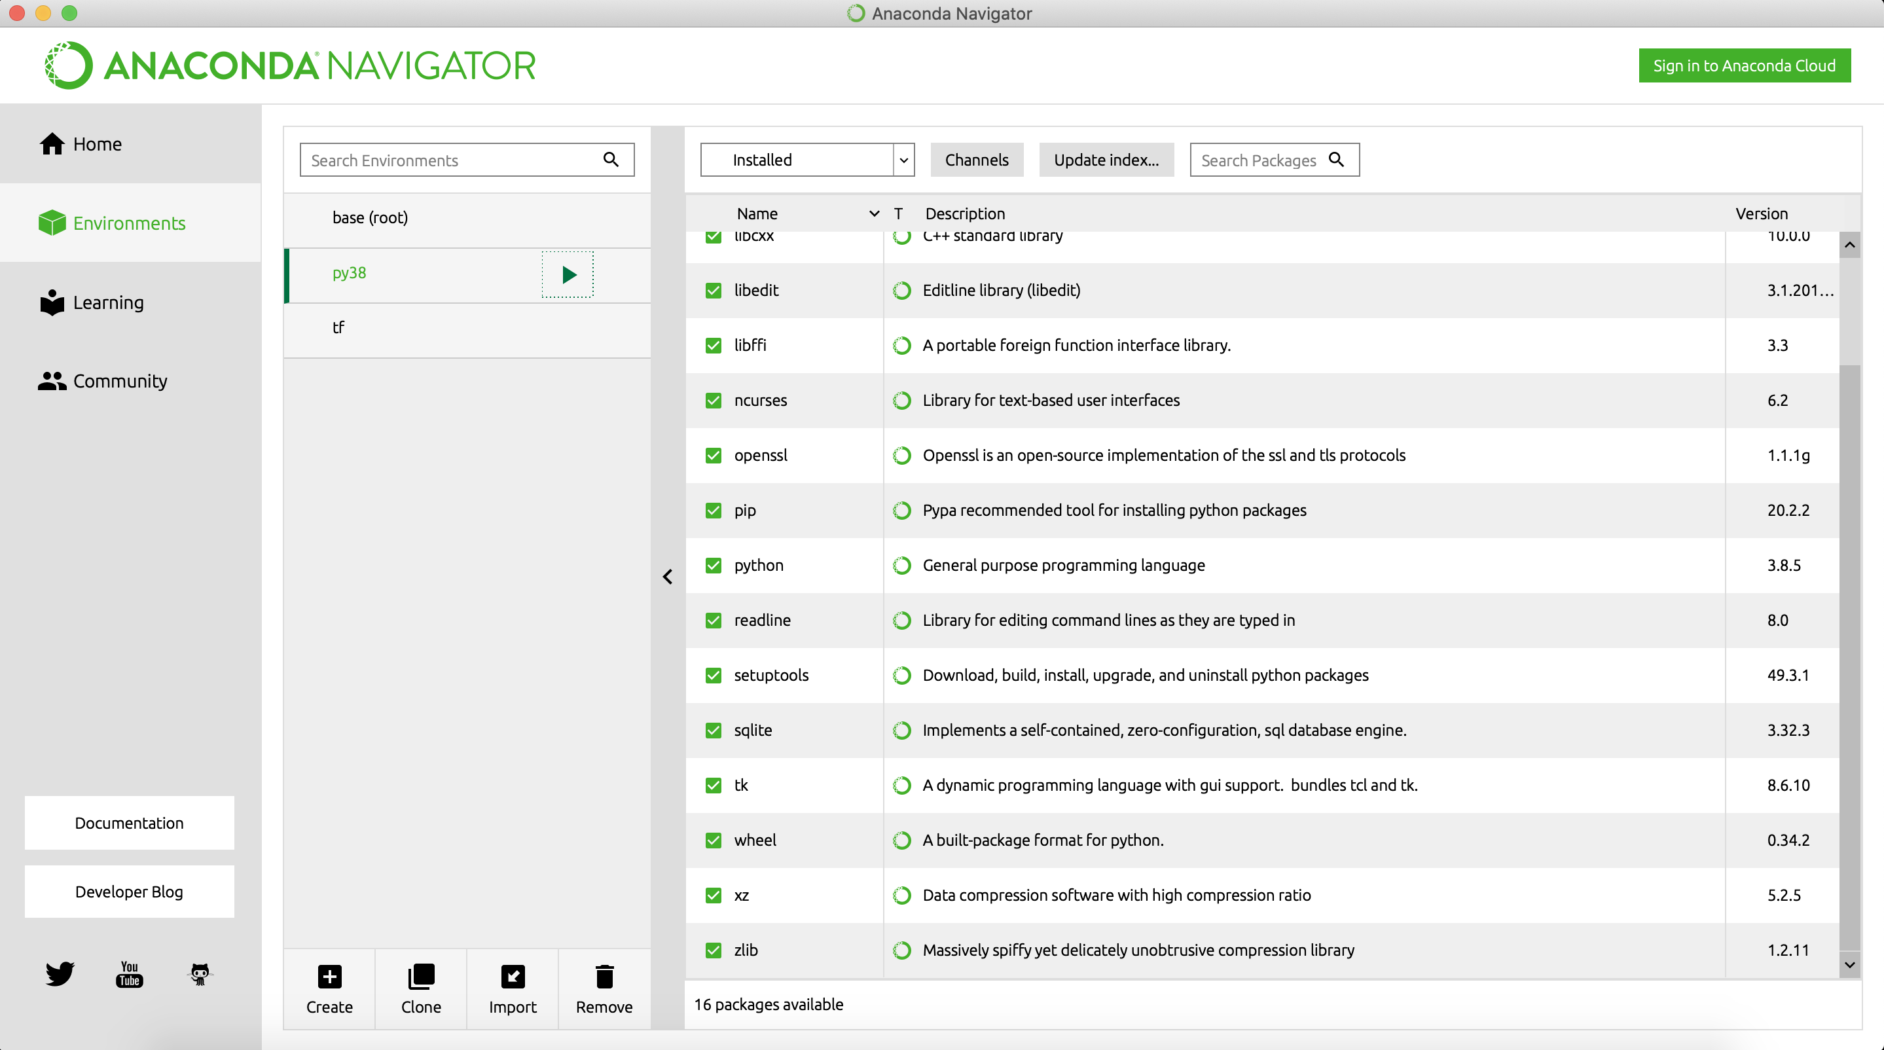
2. Create a new environment
Click Create

Slide 70
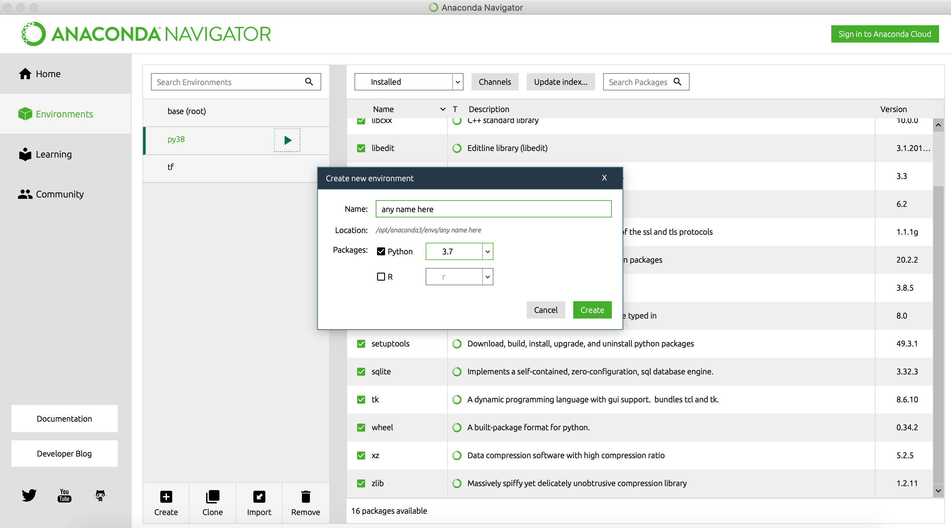
2. Create a new environment
Select Python 3.7

Slide 71
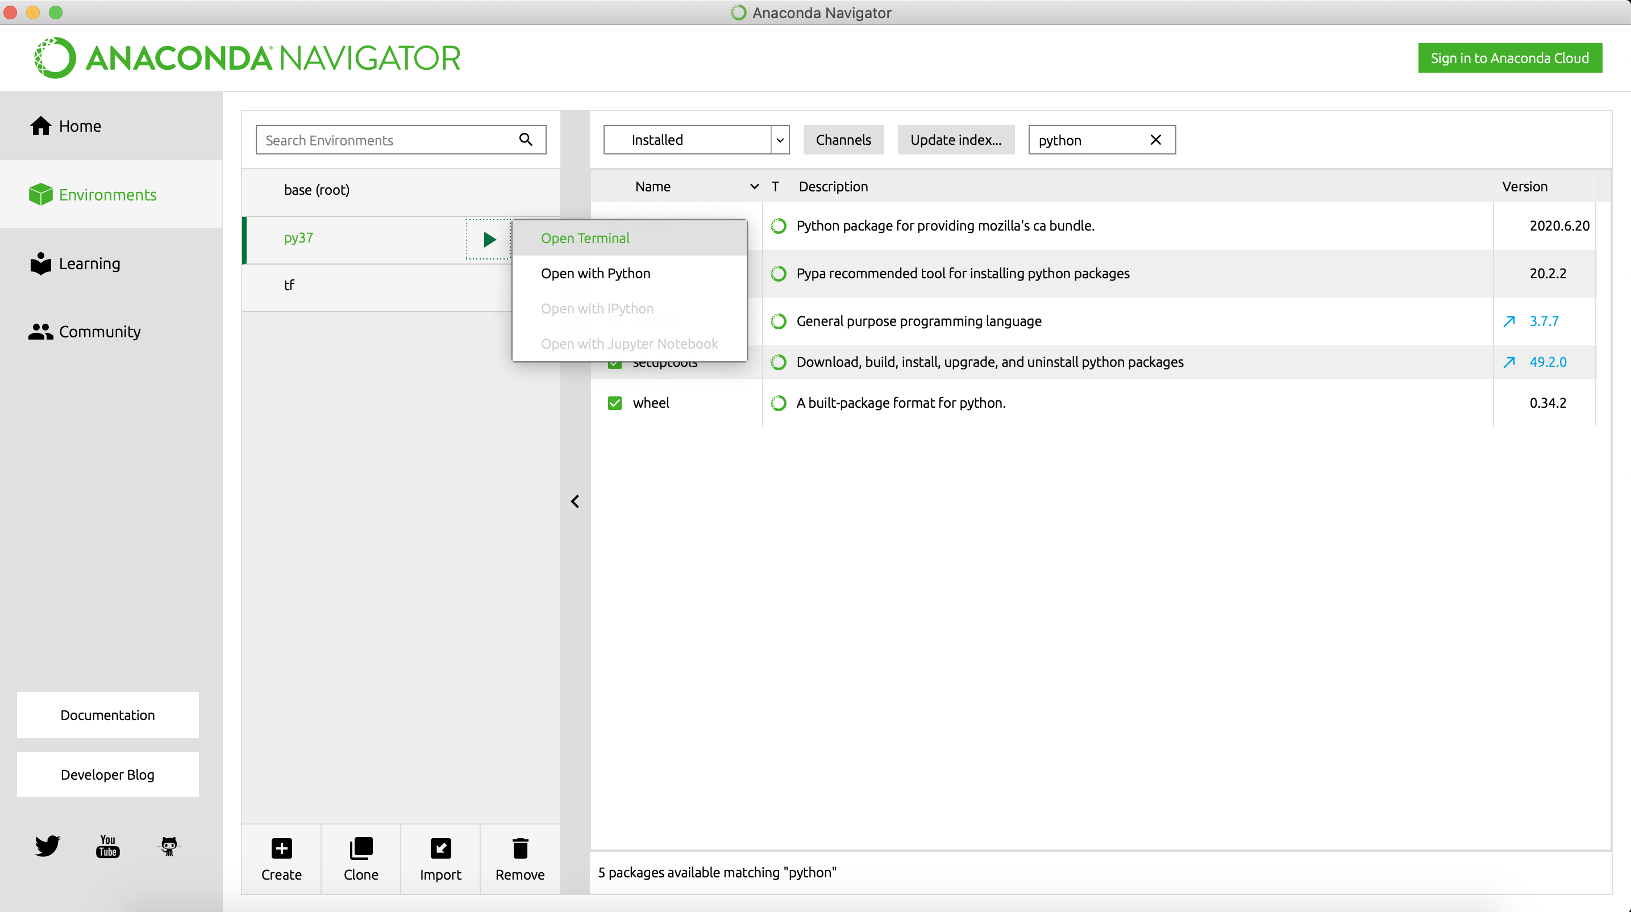
2. Create a new environment
Click Open Terminal, and install Gurobi from there
You need to switch to this environment (by clicking it in the Environment tab) before you go back to the Home tab and open Jupyter notebook

Slide 72
Homework 0
Install ROME and test out Sudoku code with ORT-Tools and Gurobi Solvers
Notes:
What should you do if you have some error? For example, “No module ‘rsome’”

